Slide 1
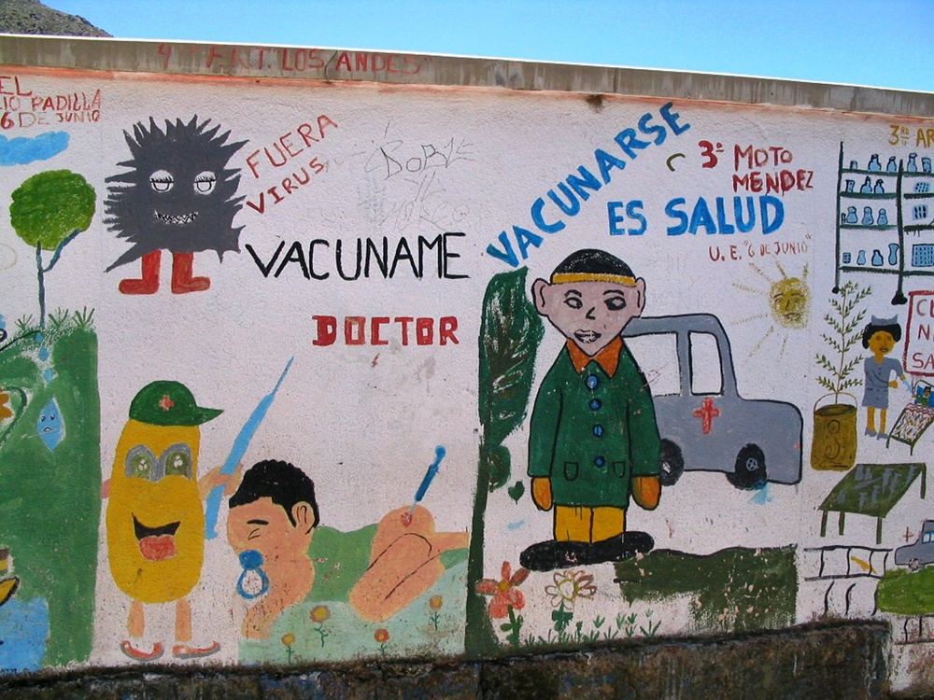
An Introduction to the Geography of Health
Chapter 1: Introduction
Photo by Heike Alberts

Slide 2
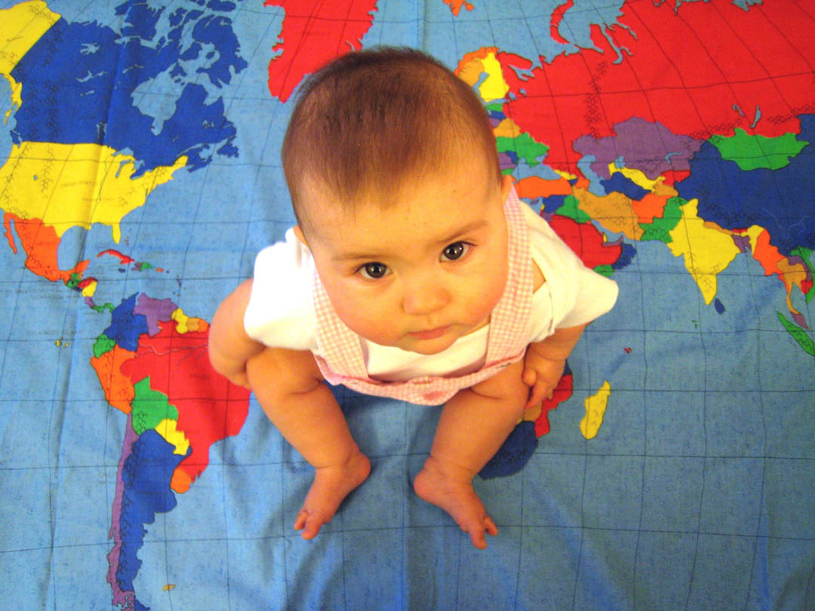
What is the geography of health?
The geography of health, sometimes called medical geography, uses the tools and approaches of geography to tackle health-related questions.
Geographers focus on the importance of variations across space, with an emphasis on concepts such as location, direction, and place.
Photo by Helen Hazen
Anthamatten and Hazen
Chapter 1

Slide 3
In thinking spatially, geographers distinguish between space, which is concerned with locating where things are, and place, which refers to the cultural meaning of a particular setting. Both these aspects of geography inform health geographers’ work.
Spatial questions consider how and why things are distributed or connected in the way they are.
Questions related to place consider how cultural constructions of a place influence the people who live there.
3
Anthamatten and Hazen
An Introduction to the Geography of Health
Chapter 1

Slide 4
What is the geography of health?
Some questions posed by a health geographer could include:
How does a particular environment influence health?
How does human activity affect health in different locations?
How does disease spread across space?
How do people’s interactions with and feelings about a particular place influence their health?
4
Anthamatten and Hazen
An Introduction to the Geography of Health
Chapter 1
Notes:
4

Slide 5
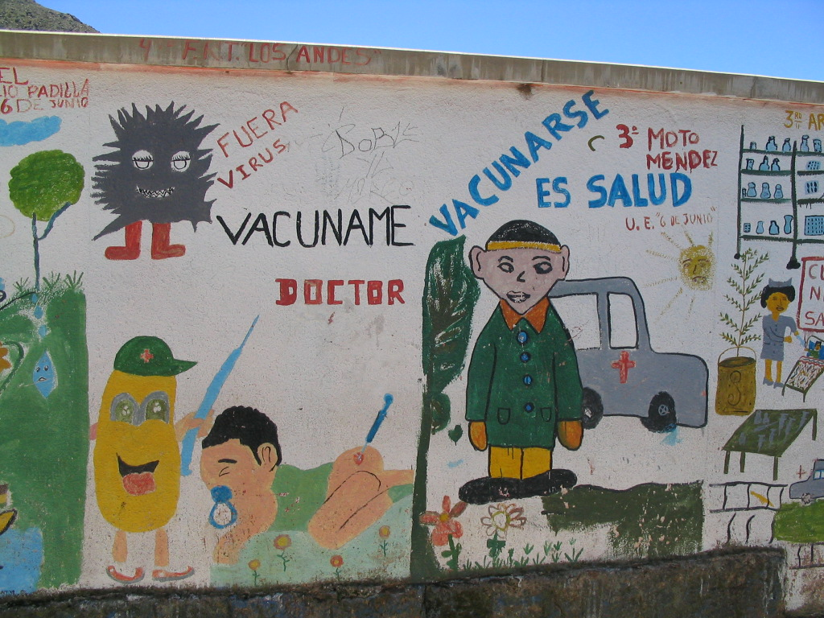
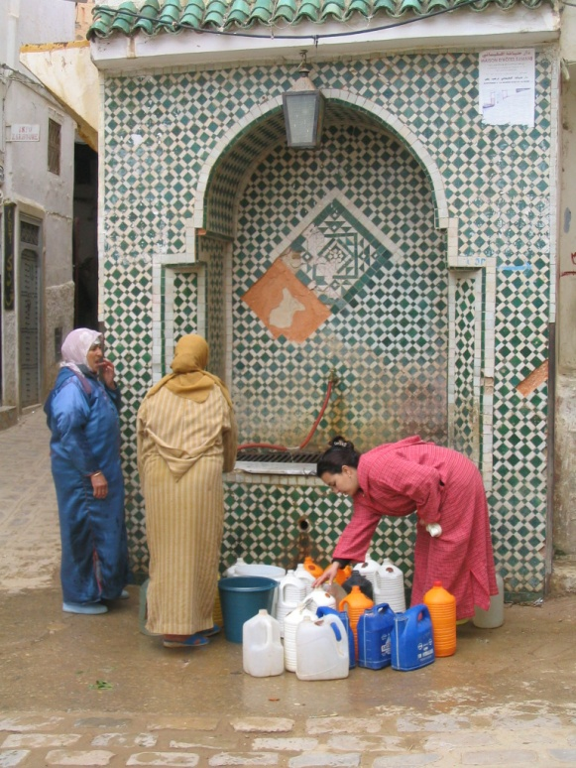
Vaccination campaign, Bolivia
Collecting water, Morocco
What questions might health geographers ask related to these images?
Photos by Heike Alberts
Anthamatten and Hazen
Chapter 1

Slide 6
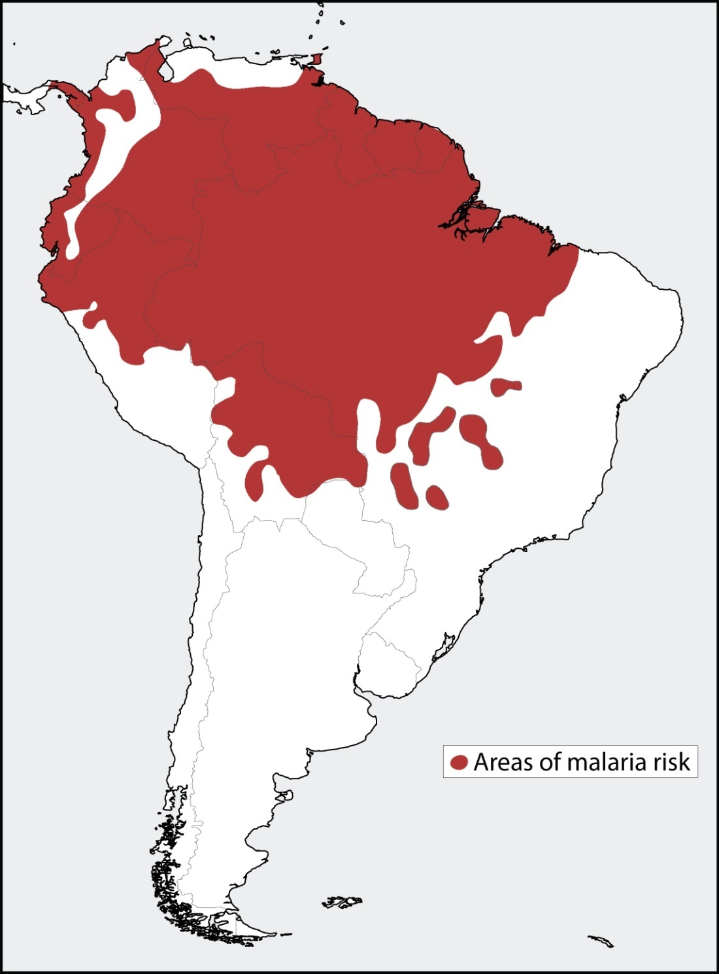
Geographers often use maps as a tool to explore spatial patterns and questions.
This map shows the general distribution of malaria in South America.
Data source: Guerra et al. (2008)
Anthamatten and Hazen
Chapter 1

Slide 7
What is it about the natural and built environments of certain places that makes them vulnerable to malaria?
Data source: Guerra et al. (2008)
Anthamatten and Hazen
Chapter 1

Slide 8
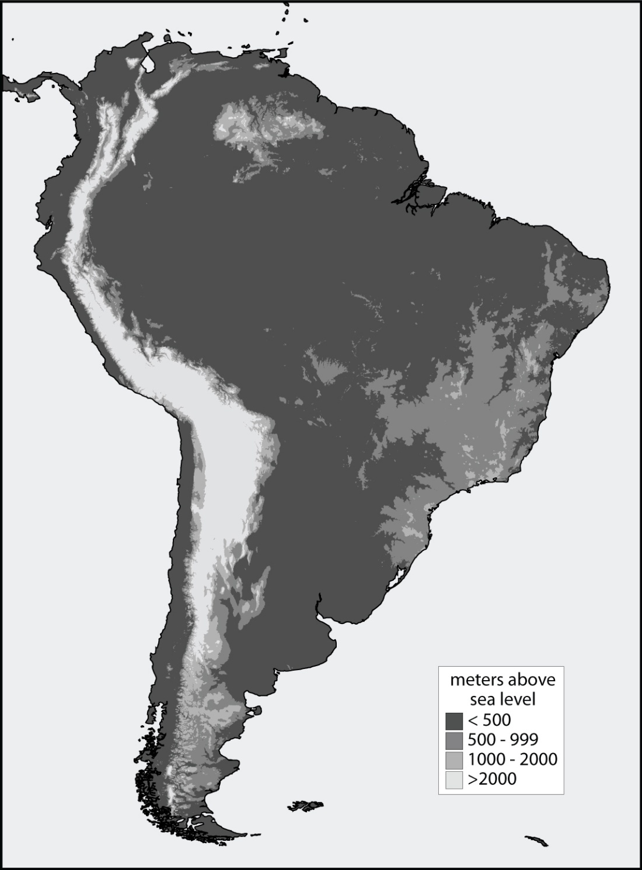
How might elevation influence rates of malaria?
Data source: USGS EROS (1996)
Anthamatten and Hazen
Chapter 1

Slide 9
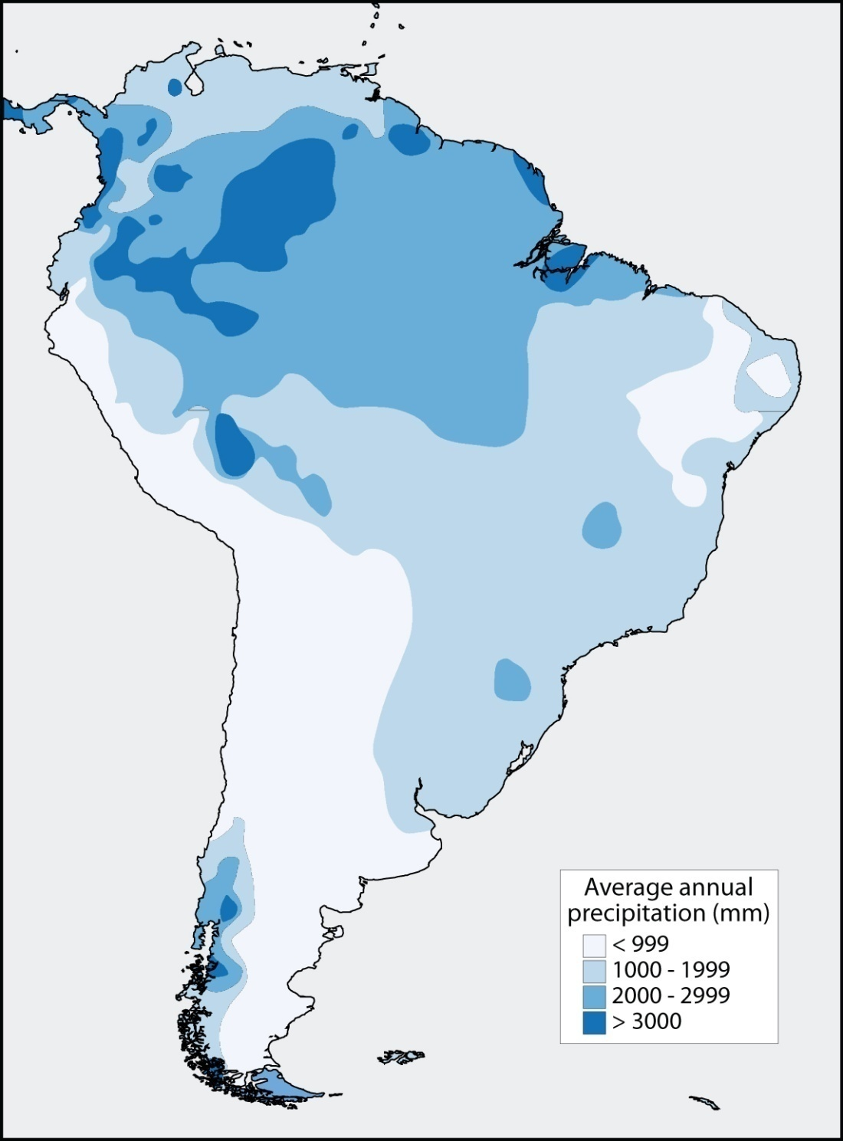
How about precipitation?
Data source: Legates and Willmott (1990)
Anthamatten and Hazen
Chapter 1

Slide 10
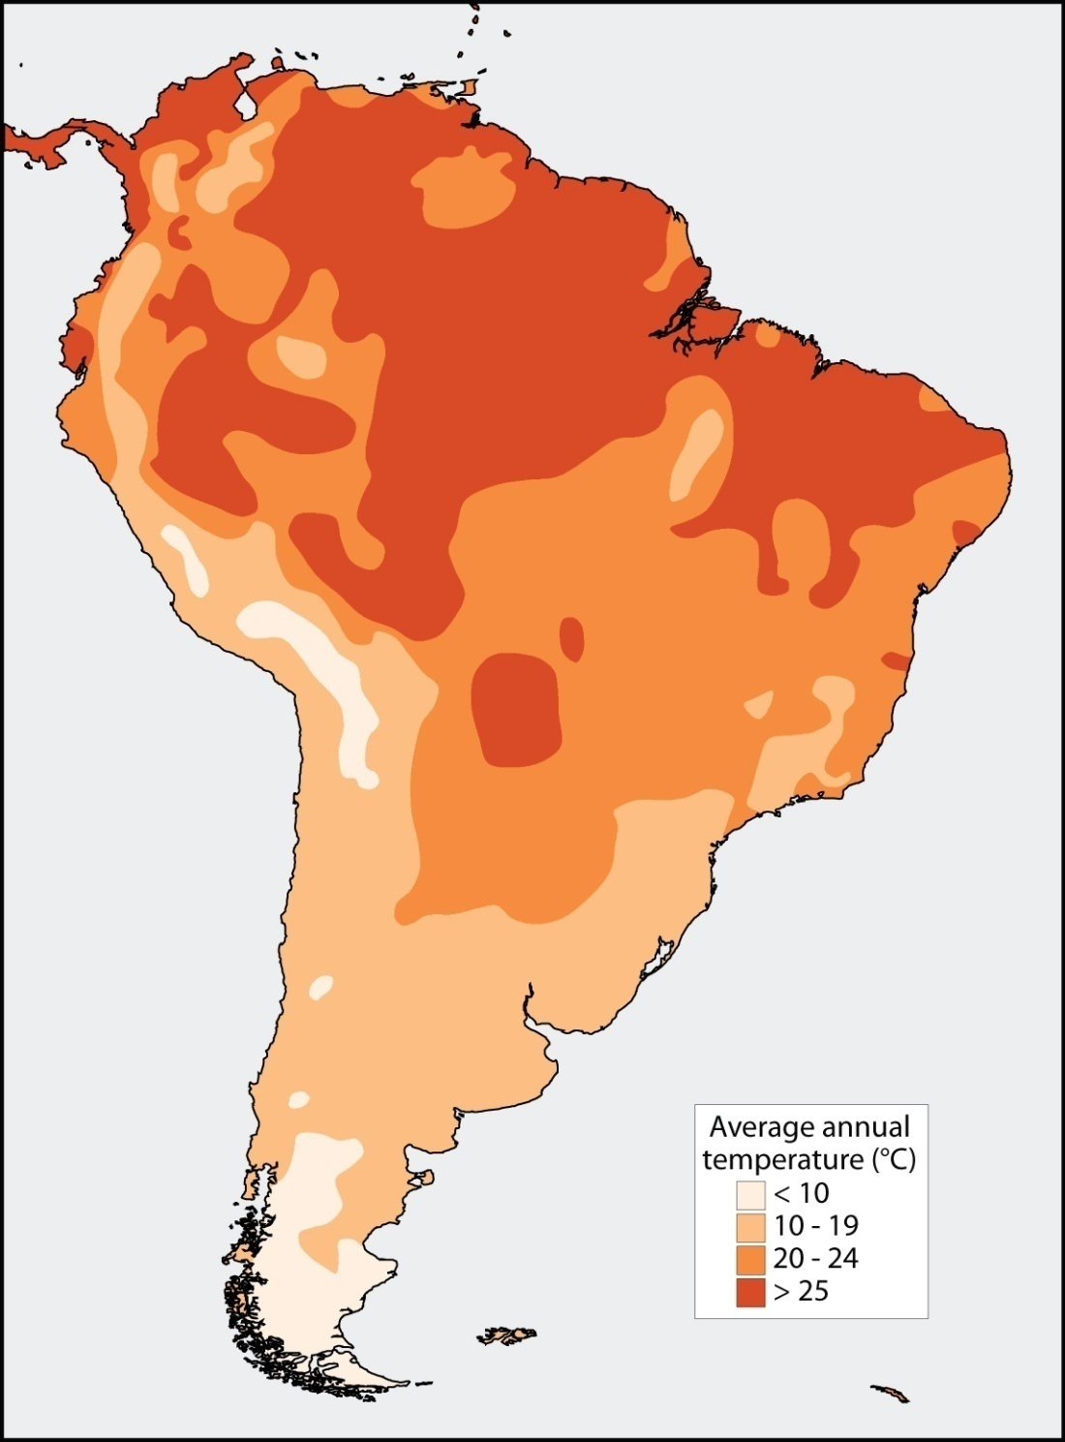
How about temperature?
Data source: Legates and Willmott (1990)
Anthamatten and Hazen
Chapter 1

Slide 11




Which of these three factors seems to be the most closely related to malaria?
Beyond these physical factors, what else might help explain the distribution of malaria?
Elevation
Rainfall
Temperature
Anthamatten and Hazen
Chapter 1

Slide 12

Approaches to Health Geography
Traditionally, health geographers have referred to their sub-discipline as “medical geography.” Recently, a group of critical scholars has argued that this term emphasizes biomedical approaches to health over others.
Today, many health geographers use the term “health geography” for their sub-discipline, in recognition of its emphasis on social as well as biomedical aspects of health.
These doctors are conducting research at the Enteric Bacteriology Unit at the Communicable Disease Center (now known as the Centers for Disease Control).
Source: Centers for Disease Control (1980)
Anthamatten and Hazen
Chapter 1

Slide 13
We can recognize three broad approaches to studying the geography of health:
ecological approaches
social approaches
spatial approaches
Anthamatten and Hazen
Chapter 1

Slide 14
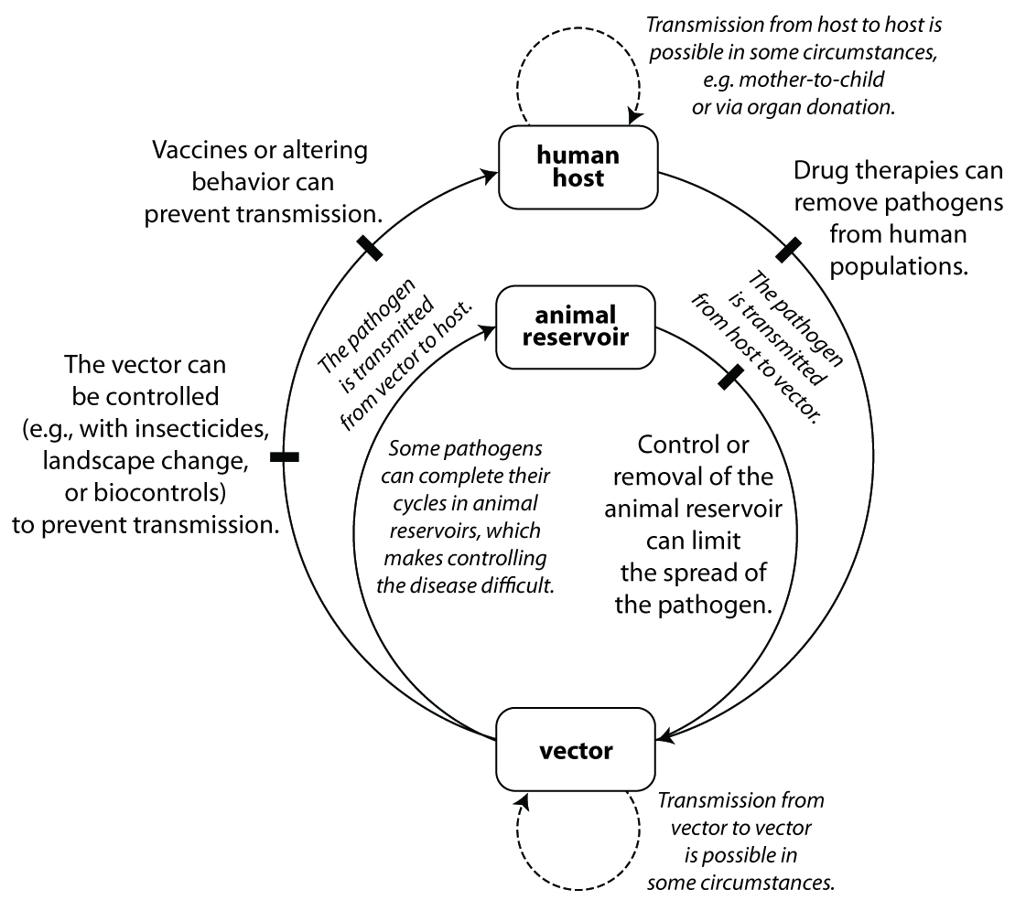
Ecological Approaches
Ecological approaches focus on humans as biological entities, recognizing that people are part of interdependent ecological systems.
Anthamatten and Hazen
Chapter 1

Slide 15
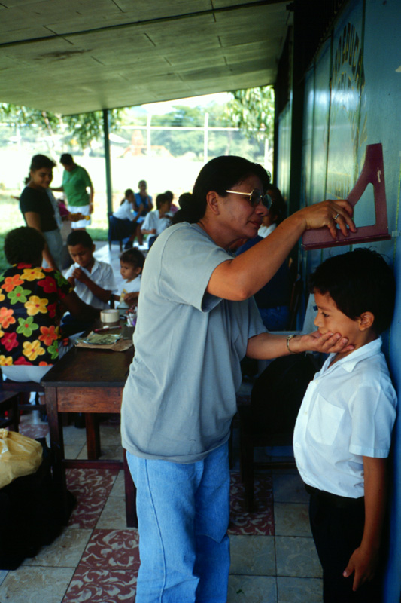
Social Approaches
Social approaches consider the ways in which human health and well-being are influenced by social, rather than biological, factors.
Photo by Peter Anthamatten
Anthamatten and Hazen
Chapter 1

Slide 16
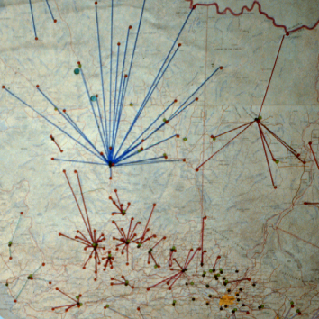
Spatial Approaches
Spatial-analytical techniques explicitly investigate the importance of spatial attributes such as location and connectivity.
Photo by Peter Anthamatten
Anthamatten and Hazen
Chapter 1

Slide 17
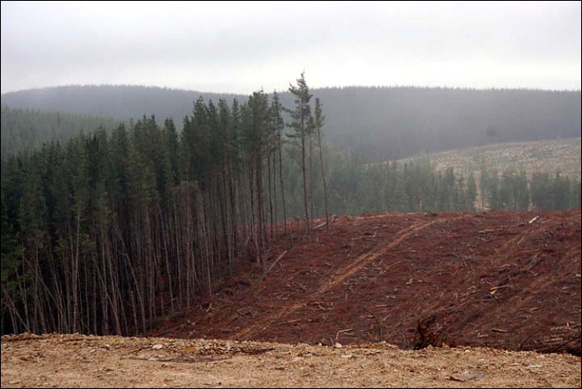
Combining Approaches
Combining approaches often provides the best way to tackle complex health problems.
With a partner, generate an ecological, social, and spatial health-related question that we could consider with respect to this image.
Photo by Helen Hazen
How might we approach these three questions using different methods?
Anthamatten and Hazen
Chapter 1

Slide 18
Discussion Questions
Discuss the geographic aspects of a current health-related news story.
Do you think that the doctrine of specific etiology (one cause is necessary and sufficient to cause disease) is sufficient for explaining phenomena such as malaria, cancer, depression, or alcoholism? Why or why not? What other factors do you think are important?
What is health? What causes disease? How is health place-specific?
How would you describe the sub-discipline of health geography to a layperson?
Anthamatten and Hazen
Chapter 1

Slide 19
References
CDC (date unknown) “Image ID# 12108” Public Health Image Library [Online]. Available: <http://phil.cdc.gov/phil/download.asp> (Accessed 11 Jan 2011).
Guerra, C. A., Gikandi, P. W., Tatem, A. J., Noor, A. M., Smith, D. L., Hay, S. I. and Snow, R. W. (2008) "The limits and intensity of Plasmodium falciparum transmission: Implications for malaria control and elimination worldwide", Plos Medicine, 5: 300–11.
Legates, D. R. and Willmott, C. J. (1990) "Mean seasonal and spatial variability in gauge-corrected, global precipitation,",
International Journal of Climatology, 10: 111–27.
United States Geological Survey Earth Resources Observation and Science Center. (1996) Global 30 Arc-Second Elevation (GTOPO30) [Online]. Available: <http://eros.usgs.gov/#/Find_Data/Products_and_Data_Available/GTOPO30> (Accessed 03 November 2010).
Anthamatten and Hazen
Chapter 1

